Slide 1
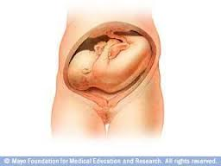
Transvers & oblique lie
Dr. Ali F. Al-Assadi
Prof. of Obstetrics & Gynecology

Slide 2
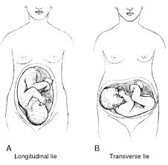
Transvers & oblique lie (shoulder presentation)
The fetus lies with its long axis transverse or oblique in the uterus, when the point of the shoulder is usually the presenting part. Occur 1:325-500.
Etiology:
Multiparous with lax abdominal wall.
Contracted pelvis, placenta previa & pelvic tumors.
Prematurity.
Polyhydramnios
IUD
Twin
Abnormal uterine shape.

Slide 3
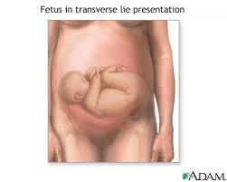
Diagnosis
Positions: dorso-anterior (commonest), dorso-posterior, dorso superior & dorso-inferior.
Diagnosis:
A- abdominal examination: the uterus appears asymmetrical, broader than usual with the fundus lower than the expected for date; on palpation the head is in one of the iliac fossae, no presenting part is felt over the brim.

Slide 4
Diagnosis
B- Vaginal examination: high presenting part, the membranes rupture early in labour& when the cervix dilated an arm or loop of cord may be prolapsed, the acromion process & adjacent ribs may also be felt, the arm should be differentiated from a leg by the absence of heel & abduction of the thumb.
C- X-ray & ultra sound.

Slide 5
Course of labour
The fetus can’t be born vaginally unless it is macerated or very premature. There is no mechanism of labor & untreated cases will end in obstructed labor & fetal death.
Neglected cases can end with rupture uterus.

Slide 6
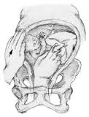
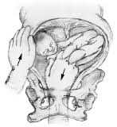
Treatment
During early labor: before the membranes rupture, ECV may correct the abnormality. Followed by amniotomy & uterine stimulation to maintain longitudinal lie. If oblique or transverse lie persist in labor CS is performed. In cases of T-lie of the second twin with intact membranes & full cx dilatation internal podalic version may be attempted in which the fetal legs are pulled down & followed by breech extraction.

Slide 7
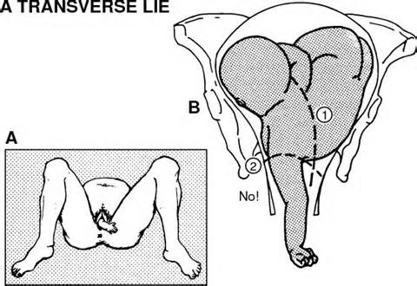
Treatment
Late in labor with impacted shoulder: if with dead fetus CS is the safest procedure, rarely decapitation is done in areas with no facilities for CS.

Slide 8
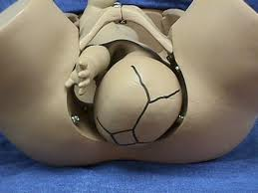
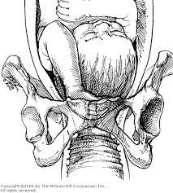
Compound presentation:
Occur in 1:650- 1250; it includes cases of cephalic presentation when one or more limbs lie alongside & presented with the head & also breech presentation when one or both arms presented with the breech.

Slide 9
Etiology
Contracted pelvis & pelvic tumors.
Polyhydramnios.
Deflection of the head.
Dead macerated fetus.
The commonest is head + hand (75%).

Slide 10
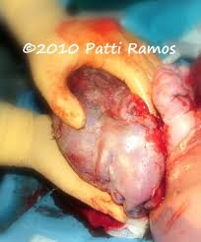
Management
Diagnosis: Is easy after the membranes are ruptured.
Management: exclude congenital anomalies, CPD & contracted pelvis, finally cord prolapse if the fetus is a live. In general expectant treatment is chosen as in most of the cases the extremity of the limb will recede as the presenting part descends, active treatment is
necessary in cases of cord
prolapse with live fetus or CPD
when CS is indicated.

Slide 11
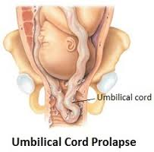
Prolapse & presentation of the umbilical cord
Occur 1: 200-300 deliveries. Whilst the membranes remain intact, the condition is that of presentation, which becomes cord prolapse when the sac rupture. The fetal mortality is lower in cases of cord presentation compare to cord prolapse.

Slide 12
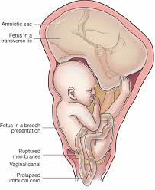
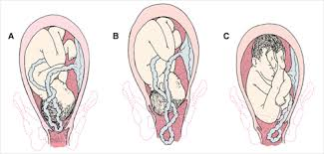
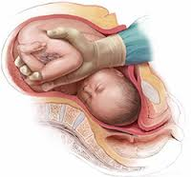
Aetiology
Etiology:
Malpresentation & nonengagement of the presenting part.
Prematurity.
Operative maneuver.
Multiparity.
Abnormal cord eg. Long cord or
low placental insertion.

Slide 13
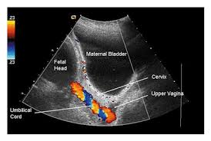
Diagnosis
It should be suspected if there is fetal heart rate variation (variable deceleration). One may feel coils of cord within the forewater before the membranes rupture in such presentation it is important to keep the membranes intact while preparing for CS. In prolapse coils of cord are felt within the vagina & in this situation, cx dilation, level of the presenting part & presentation must be noted as well as pulsation in the cord.

Slide 14
Management
Vaginal delivery is indicated if the fetus is dead or has lethal congenital anomalies. A trial of labor with instrumental delivery may also be allowed if the cx is 8 cm dilated with deeply engaged head.
Cases other than the above must be treated as follow:

Slide 15
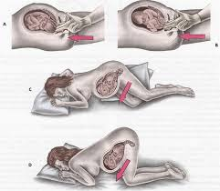
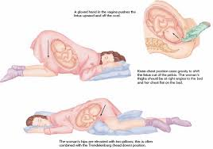
Emergency measures:
prevent cord compression by postural treatments that involve keeping the fingers in the vagina & placing the patient in Sims or Trendlenburg’s position. It has been suggested that rapid forceful instillation of 500- 700 ml of saline into the bladder via a Foley’s catheter is also effective. The cord should be replaced within the warm, moist vagina, so preventing the vasospasm that results from cold & local irritation.

Slide 16
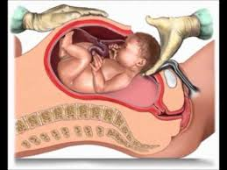
Definitive treatment is to deliver the fetus by CS. Definitive treatment
Is to deliver the fetus by CS.

